Slide 1
Chapter 10
Helping Others

Slide 2
Why do we help?
Prosocial behaviors
  Actions intended to benefit others
From an evolutionary perspective, what is the function of helping others?

Slide 3
Who do we help?
Evolutionary perspectives emphasize not the survival of the fittest individuals but the survival of individuals’ genes.
Kin selection
  Preferential helping of genetic relatives, which results in the greater likelihood that genes held in common will survive.

Slide 4
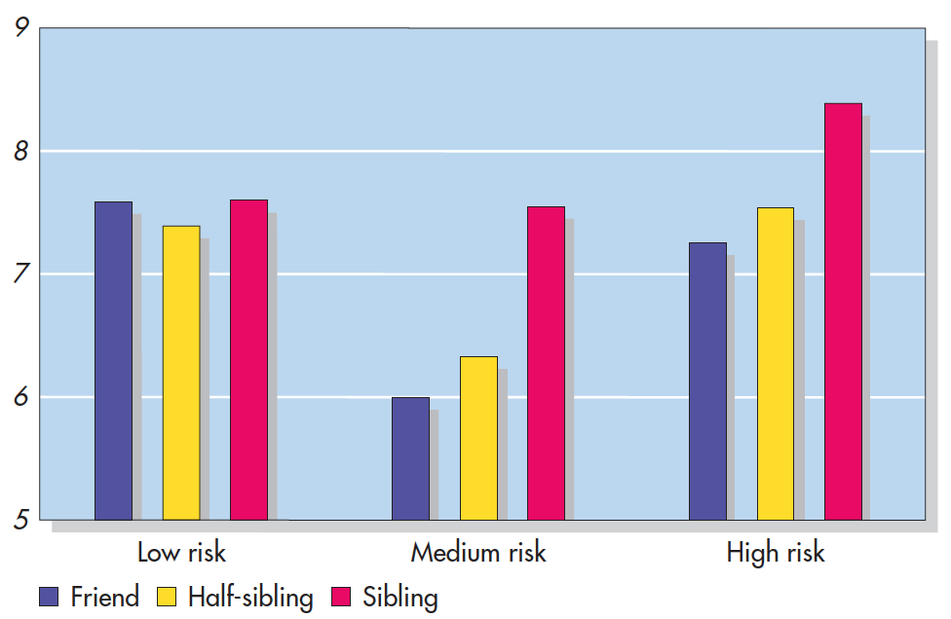
Helping Kin When Risks Are High (Fitzgerald & Colarelli, 2009)
Notes:
Figure 10.1 Helping Kin When Risks Are High Participants indicated how willing they would be to offer different types of help to a friend, a half-sibling, or a sibling. For the low-risk helping, participants were as willing to help a friend as they were to help a sibling. For high-risk helping, in contrast, they were more willing to help a sibling than a friend, with willingness to help a half-sibling coming in the middle.
Based on Fitzgerald & Colarelli, 2009.

Slide 5
Motivations for helping
Egoistic
  Motivated by the desire to improve one’s own welfare
Altruistic
  Motivated by the desire to improve another’s welfare
Is all helping egoistic at some level?

Slide 6
Motivations for helping
Altruistic behavior activates areas of the brain associated with receiving actual material rewards.
Negative state relief model
  The proposition that people help others in order to counteract their own feelings of sadness.

Slide 7
Reciprocal Altruism
Reciprocal altruism
  Altruism that involves an individual helping another (despite some immediate risk or cost) and becoming more likely to receive help from the other in return

Slide 8
The Evolution of Empathy
Empathy
  Understanding or vicariously experiencing another individual’s perspective and feeling sympathy and compassion for that individual.
Perspective taking—using the power of imagination to try to see the world through someone else’s eyes
Empathic concern—involves other-oriented feelings such as sympathy, compassion, and tenderness.

Slide 9
Costs of Helping or of Not Helping
Courageous resistance—providing sustained and deliberate help in the face of potentially enormous costs
  Often associated with positive affect, and health, when taking long-term care of a very ill person
Most people seem to do a cost–benefit analysis before deciding to help strangers.

Slide 10
The Empathy–Altruism Hypothesis (1 of 2)
Empathy–altruism hypothesis
  The proposition that empathic concern for a person in need produces an altruistic motive for helping.
True altruism occurs when the focus is on the other person, not on how you would feel in that person’s situation.

Slide 11
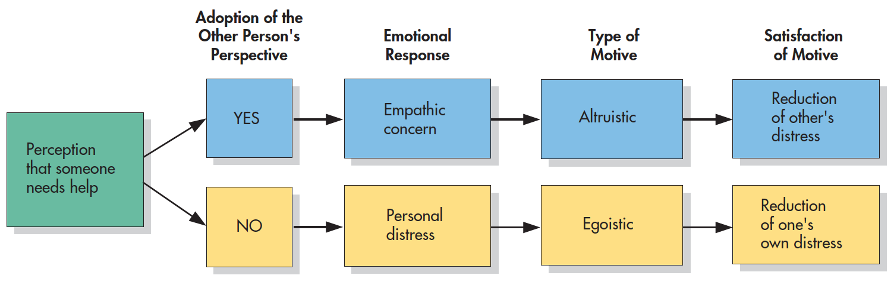
The Empathy–Altruism Hypothesis (2 of 2)
Notes:
Figure 10.4 The Empathy-Altruism Hypothesis According to the empathy–altruism hypothesis, taking the perspective of a person in need creates feelings of empathic concern, which produce the altruistic motive to reduce the other person’s distress. When people do not take the other’s perspective, they experience feelings of personal distress, which produce the egoistic motive to reduce their own discomfort. Based on Batson, 1991.

Slide 12
Convergence of Motivations: Volunteering
People tend to engage in more long-term helping behavior, such as volunteerism, due to multiple motives.
  Altruistic and egoistic
Egoistic motives may remain longer as active volunteers than altruistic motives.
  More personally invested?

Slide 13
Motivations to Volunteer
Examples of some of the many motivations behind why people volunteer
Values | Community Concerns
We have humanitarian obligation to help others | I want to advocate for this community
Understanding | Esteem Enhancement/Atonement
I want to learn more about people who are suffering with a particular issue or problem | I want to feel better about myself; I want to make up for my mistakes
Personal Development | Requirements and Norms
I want to meet new people and make new friends | I need to do a service project for school or because of my religion
Extrinsic
I want to improve my reputation or career
Notes:
Table 10.1 Motivations to Volunteer Based on Hu, 2019; Omoto & Snyder, 1995; Stukas et al., 2016.

Slide 14
Helping as a Default?
Are we helpful by nature?
Maybe?
  Only consider costs if we have the time to
Acting fast, on instinct, often produces more helping and cooperative behaviors than when there is time to consider costs and benefits of their actions.

Slide 15
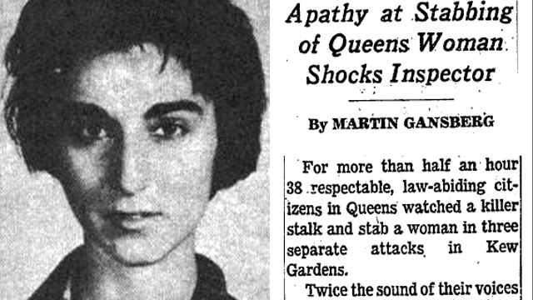
The Bystander Effect (1964)

Slide 16
The Bystander Effect
Details of Kitty Genovese case greatly exaggerated!
  New York times published made up number of bystanders; public ran wild with it
  Police were called, however attack happened before NYC had 911 system
  Bystanders who were present likely heard by did not see the attack happen
    Likely that only one person actually witnessed the attack

Slide 17
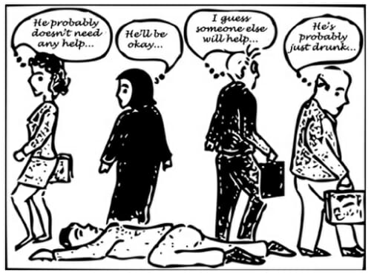
The Bystander Effect
The Kitty Genovese story generated interest in “The Bystander effect”
  The effect whereby presence of others inhibits helping

Slide 18
The Bystander Effect
Latane & Darely’s Experiments (1960’s)
  Participants are alone or among a group of people
  An emergency is staged. Will the participant intervene?

Slide 19
Latane & Darely (1968)
Individuals taken to a small room with a microphone
  Cover story: How do individuals adjust to life in New York City? (subjects were new NYU students)
  Manipulated how many people the individual thought they were talking with:
    1 other vs 2 vs 5
  Confederate begins to speak over the microphone and has a seizure
  Research question: Does the perceived presence of others influence helping

Slide 20
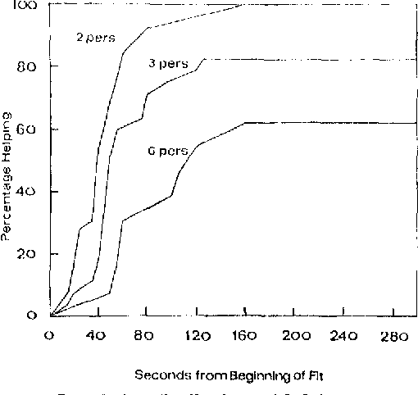
Latane & Darely (1968)
Perceived presence of others greatly impacted helping behaviors
1
2
5

Slide 21
Noticing
The presence of others can sometimes be distracting and divert attention away from noticing a victim’s plight.
  Stanley Milgram (1970) called Stimulus overload

Slide 22
Interpreting
The more ambiguous the situation is, the less likely it is that bystanders will intervene.
Pluralistic ignorance
  People in a group mistakenly think that their own individual thoughts, feelings, or behaviors are different from those of the others in the group.

Slide 23
Taking Responsibility
Diffusion of responsibility
  The belief that others will or should take the responsibility for providing assistance to a person in need.
Diffusion of responsibility cannot occur if an individual believes that only they are aware of the victim’s need.

Slide 24
Deciding How to Help and Providing Help
Audience inhibition
  Reluctance to help for fear of making a bad impression on observers.
  Concern about being embarrassed in front of friends and breaking perceived norms that promote minding one’s own business contributes to a shocking number of instances of bystander inaction.

Slide 25
Time Pressure
Time pressure can conflict with one’s good intentions of helping
  May fail to notice others who need help
  May become less likely to accept responsibility for helping someone
  May decide that the costs of helping are too high

Slide 26
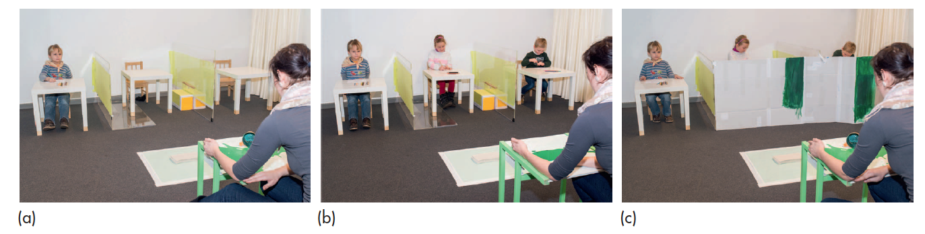
The Bystander Effect and Diffusion of Responsibility Among Children (Plotner et al., 2015)
Notes:
Figure 10.7 Bystander Effect and Diffusion of Responsibility Among Children These photos re-create the experimental setup in the three conditions of a study to see if 5-year-olds would help an experimenter by bringing over paper towels to deal with a spill. When participants were alone with the experimenter (Photo A), they were much more likely to help the experimenter than if they were in the presence of two confederates (Photo B). However, if the two confederates were trapped behind a barrier and thus unable to help (Photo C), responsibility for helping could not be diffused, and the participants were as likely to help as if they were alone. From Plötner et al., 2015.

Slide 27
When Intervention Is More Likely to Occur
There are conditions in which the bystander effect is less likely to occur or may even be reversed.
  The bystanders know or feel connected to each other.
  Effective helping would require multiple helpers.
  People feel they will be scorned for failing to help.
A person in a leadership role, or who is in a helping occupation, is more likely to help.

Slide 28
Getting Help in a Crowd: What Should You Do?
Counteract the ambiguity of the situation by making it very clear that you do need help.
Reduce diffusion of responsibility by singling out particular individuals for help with:
  Eye contact
  Pointing
  A direct request

Slide 29
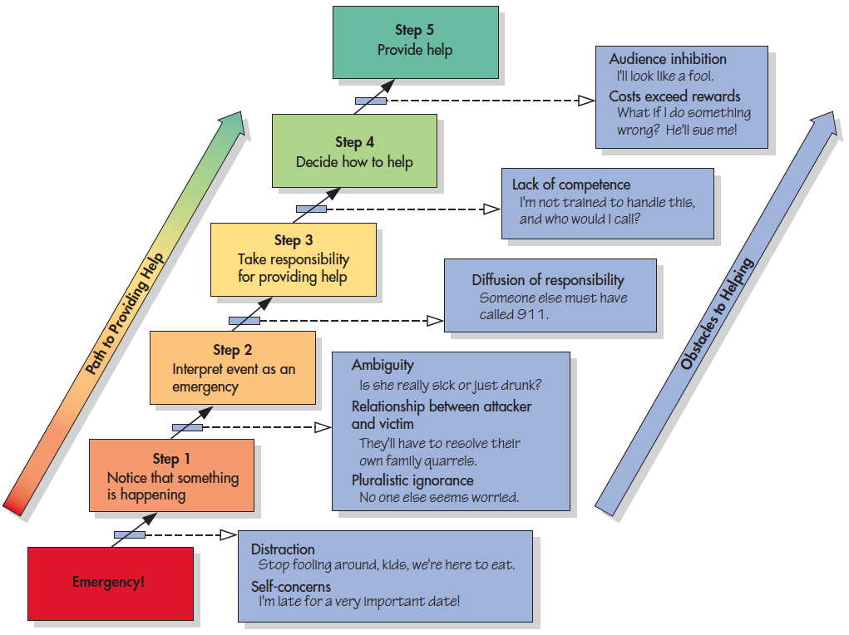
The Five Steps to Helping in an Emergency
Notes:
Figure 10.6 The Five Steps to Helping in an Emergency On the basis of their analysis of the decision-making process in emergency interventions, Latané and Darley (1970) outlined five steps that lead to providing assistance. But obstacles can interfere, and if a step is missed, the victim won’t be helped.

Slide 30
Moods and Helping & Good Moods and Doing Good
Helping someone can put people in a better mood,
  Can being in a good mood make people more likely to help someone?
Sensory conditions, such as the weather and sweet scents, can give us some clues about the relationship between good mood and helping.

Slide 31
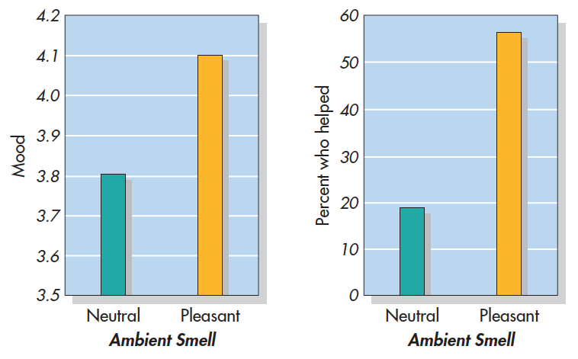
Mood and Scent (Baron, 1997)
Notes:
Figure 10.8 Scents and Sensibilities People approached by a researcher in a mall reported being in a better mood (left) and were more likely to comply to a request for change (right) if they were in an area of the mall with pleasant ambient odors than if they were in an area with no clear odors. Adapted from Baron, 1997.

Slide 32
Bad Moods and Doing Good
Negative feelings can promote prosocial behaviors.
  People know that helping makes them feel good
  Motivated to try to repair a negative mood by helping others.

Slide 33
Prosocial Media Effects
Much research on harmful effects of watching violent entertainment or playing violent video games
Might prosocial media have positive effects, including promoting prosocial attitudes and behaviors?

Slide 34
Role Models and Social Influence
Observing helpful models increases helping in a variety of situations:
  Parents are especially important role models.
  Three reasons:
    Behavior for us to imitate directly
    rewarded for their helpful behavior
    the behavior of these models make us think about and become more aware of the standards of conduct in our society.

Slide 35
Social Influence
Social influence
  Charities and other fund-raisers often are quite aware of and utilize the power of social influence to motivate donations
    encouraging people to match others’ contributions
    making public lists of who has contributed.
Reluctant altruism
  Altruistic kinds of behavior that result from pressure from peers or other sources of direct social influence.

Slide 36
Moods and Helping (Guan et al., 2019)
Notes:
Figure 10.9 Moods and Helping Participants in a pair of studies in China watched a video induced to create either a positive mood, a negative mood, or a neutral mood. In one study, participants donated more of their time to help a graduate student if they had just watched the positive video than if they
had watched the negative or neutral videos. In a different study, participants donated more money to help someone if they had watched either the positive or the negative video rather than the neutral one. This pair of studies illustrates the reliable effect of positive moods on helping and the more complicated relationship between negative moods and helping. From Guan et al., 2019.

Slide 37
Are Some People More Helpful Than Others?
Some people tend to be more helpful than others across multiple situations and over time.
There is a heritable component to helpfulness.

Slide 38
What Is the Altruistic Personality?
People who tend to be more helpful are more likely to:
  Be very agreeable
  Are relatively honest and humble
  Exhibit advanced moral reasoning
  Exhibit more empathetic concern for the suffering of a stranger

Slide 39
Culture and Helping
The role of religion in promoting prosocial behavior is also rather mixed.
  Individual differences in religiosity often do correlate with prosocial behavior, but much of this research finds a strong intergroup bias.
The relationship between individualism or collectivism and prosocial behavior is also mixed.

Slide 40
Reporting a Lost Wallet in 40 Countries (Cohn et al., 2019)
Notes:
Figure 10.12 Reporting A Lost Wallet in 40 Countries Individuals in 40 countries around the world were handed a “lost” wallet and had the opportunity to e-mail its owner to report that it had been found. Half of these wallets had no cash in it, and the other half had cash. There was wide variation across countries in the rates of reporting the wallets. In almost every country, however, people were more likely to report the wallet if there was money in it (red dots) than if there was no money in it (yellow dots). From Cohn et al., 2019.

Slide 41
Who receives help?
Are some people more likely to receive help than others?

Slide 42
Attractiveness & Attributions of Responsibility
The social advantages that physically attractive individuals enjoy
Attractive people are more likely to be offered help and cooperation across a number of different settings.
People are more likely to help someone in need if they think the person shouldn’t be held responsible for his or her predicament.

Slide 43
Helping Others
People are usually more helpful to those:
  They know and care about: Exchange versus communal relationship
  Who are similar to themselves
  Who are in their group
Identity fusion
  A strong sense of “oneness” and shared identity with a group and its individual members
Helping can also be seen as a sign of superiority over the person who needs help.

Slide 44
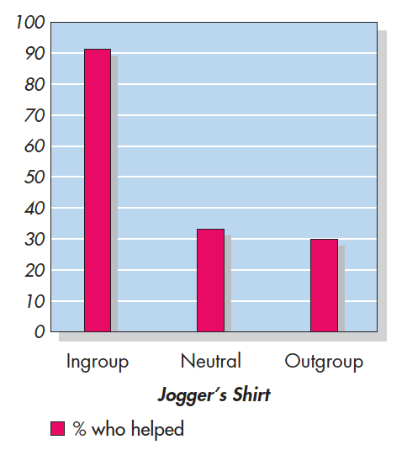
Helping Ingroup Members (Levine et al., 2005)
Notes:
Figure 10.13 Helping Ingroup Members Participants who were fans of a particular British football (soccer) team came across a fallen jogger who seemed to be in pain. They were much more likely to offer the jogger help if he was wearing a shirt of the participants’ favorite team than if he was wearing either a rival team’s shirt or a neutral shirt. Based on Levine et al., 2005.

Slide 45
Gender and Helping
Men
  More likely to help in dramatic ways when they feel in competition with another man
  Less likely than women to receive help
Women
  More likely to provide social support
There does not seem to be a general and consistent gender difference in who is most likely to help others.

Slide 46
Culture and Who Receives Help
Cultural norms vary concerning how and when to seek help.
Taylor (2007)
  seeking and receiving social support from close others is more stressful—both psychologically and physiologically—to Asian students than to American students.

